Slide 1
TypeScript
Creating and Using Classes
Lecture 5
By James(Jin) Wang
11/15/2021

Slide 2
Outline
What is a class?
Creating and using a class
Adding a constructor and properties
Adding functions

Slide 3
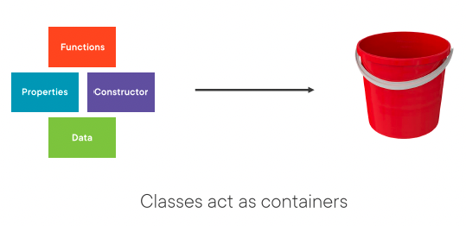
What is a Class
  The Role of Classes

Slide 4
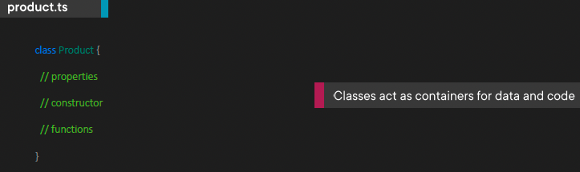
What is a Class
  Getting Started with Classes
  Classes can be used to encapsulate data and code.
  They act as templates for object instances.

Slide 5
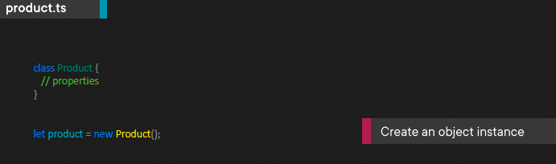
What is a Class
  Creating an Object Instance
  Classes act as templates that can be used to create object instances.

Slide 6
Creating and Using a Class
  Demo: Create and Use Class

Slide 7
Adding a Constructor and Properties
  Demo: Constructor and Property

Slide 8
Adding Functions
  Demo: Add Function

Slide 9
Extend Classes
  Demo: Extend Classes

Slide 10
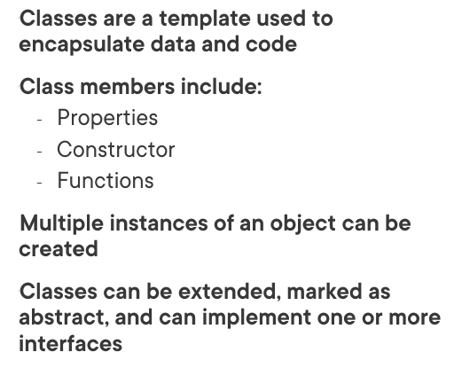
Summary

Slide 11
Assignment

Slide 12
Self Study
  Typescript Core Language Path
  TypeScript: Getting Started
  https://app.pluralsight.com/library/courses/getting-started-typescript
  TypeScript Fundamentals
  https://app.pluralsight.com/library/courses/typescript-fundamentals

